Slide 1

CHICAGO DOT CAR CRASHES ANALYSIS
Shayan Abdul Karim Khan
05/08/2023

Slide 2
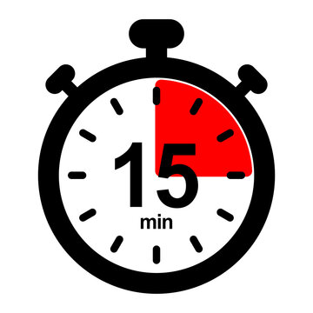

PROBLEM OVERVIEW
1 FATAL INCIDENT EVERY 15 MINUTES
Notes:
TALK ABOUT THE BUSINESS PROBLEM
VISION ZERO
WHY IS VISION ZERO IMPORTANT

Slide 3

CDOT GOALS
37% CAUSES LABELLED AS “UNABLE TO DETERMINE”
TOP FACTORS INFLUENCING CRASHES
PREDICT CAUSES OF CRASHES
MULTI-FACTOR ANALYSIS DOES NOT EXIST
PREDICT UNABLE TO DETERMINE CAUSES AND UNDERSTAND THE FACTORS BEHIND IT
Notes:
WHAT DOES CDOT WANT TO ACCOMPLISH?
UNABLE TO DETERMINE
TOP 10 THINGS THAT CONTRIBUTE TO CRASHES

Slide 4






ANALYSIS PROCESS
CHICAGO DOT DATABASE ON CRASHES, VEHICLES AND PEOPLE
ITERATIVE DATA CLEANING & PROCESSING
MODELLING
Notes:
HOW WILL WE ACCOMPLISH THIS?
DATABASE
CLEANING/PROESSING
MODELLING
TOP 10 FEATURES AND A MODEL

Slide 5
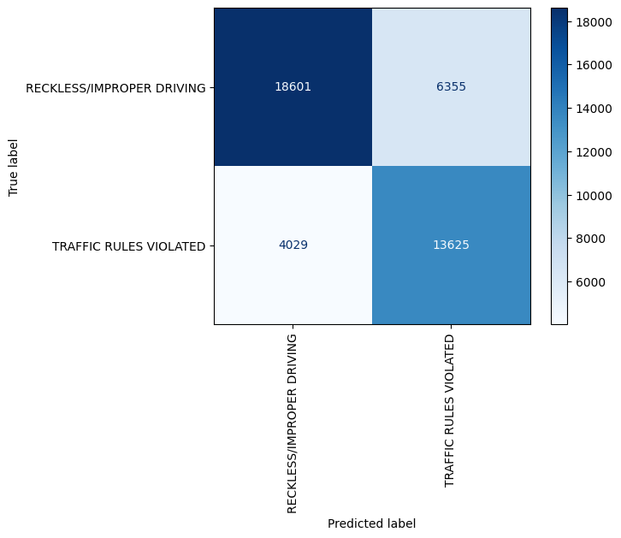
MODELING RESULTS
4
ACCURACY: 70%
PRECISION: 70%
3
ACCURACY: 73%
PRECISION: 74%
2
ACCURACY: 74%
PRECISION: 74%
1
ACCURACY: 76%
PRECISION: 76%
RANDOM FOREST MODEL CONFUSION MATRIX
Notes:
BEST PERFORMING MODEL RESULTS
DECISION TREE
KNN
RANDOM FORESTS
XGBOOST [BEST MODEL]
UNABLE TO DETERMINE DATASET RESULTS

Slide 6



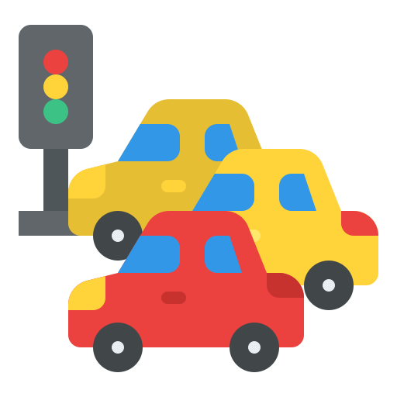

TOP FACTORS RESULTS
LATITUDE
DRIVER ACTION
LONGITUDE
MANEUVER
INTERSECTION
OCCUPANT CATEGORY
FIRST CONTACT POINT
# UNITS
WEATHER CONDITION
DEVICE CONDITION
Notes:
LOCATION BASED:
Latitude, longitude, Intersection
Driver Based:
Driver_Action, Physicial Condition, Maneuver
Traffic based:
First Contact Point, Num of units, Device Condition
Nature based:
Weather Condition

Slide 7
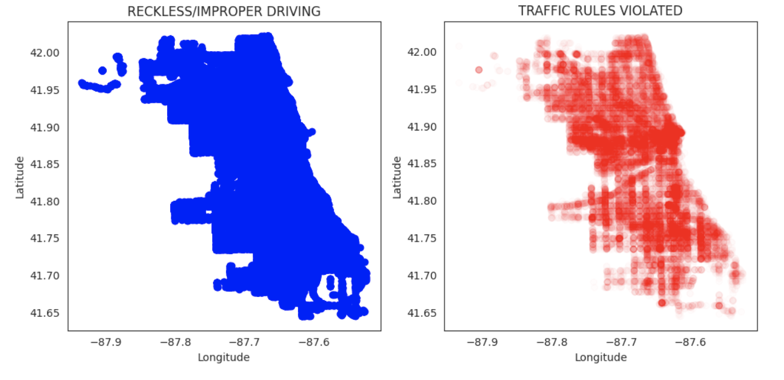
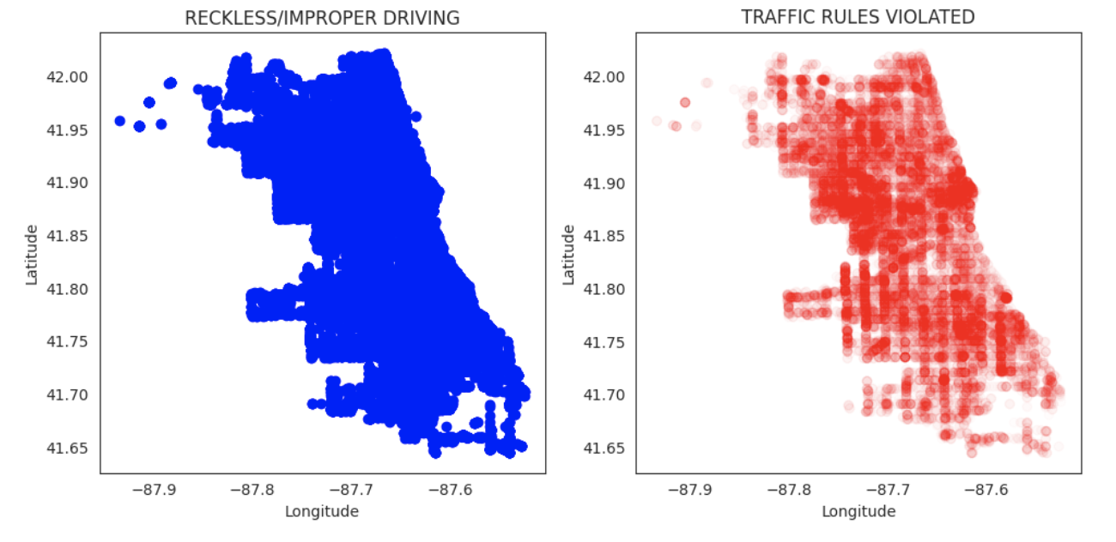
TOP FACTORS RESULTS – LAT/LONG COMPARISON
TRAINING
Similar Trend
Reckless/Improper Driving is common all over
Traffic Rules Violation is more common in densely populated areas like Downtown
PREDICTED
Notes:
LOCATION BASED:
Latitude, longitude, Intersection
Driver Based:
Driver_Action, Physicial Condition, Maneuver
Traffic based:
First Contact Point, Num of units, Device Condition
Nature based:
Weather Condition

Slide 8
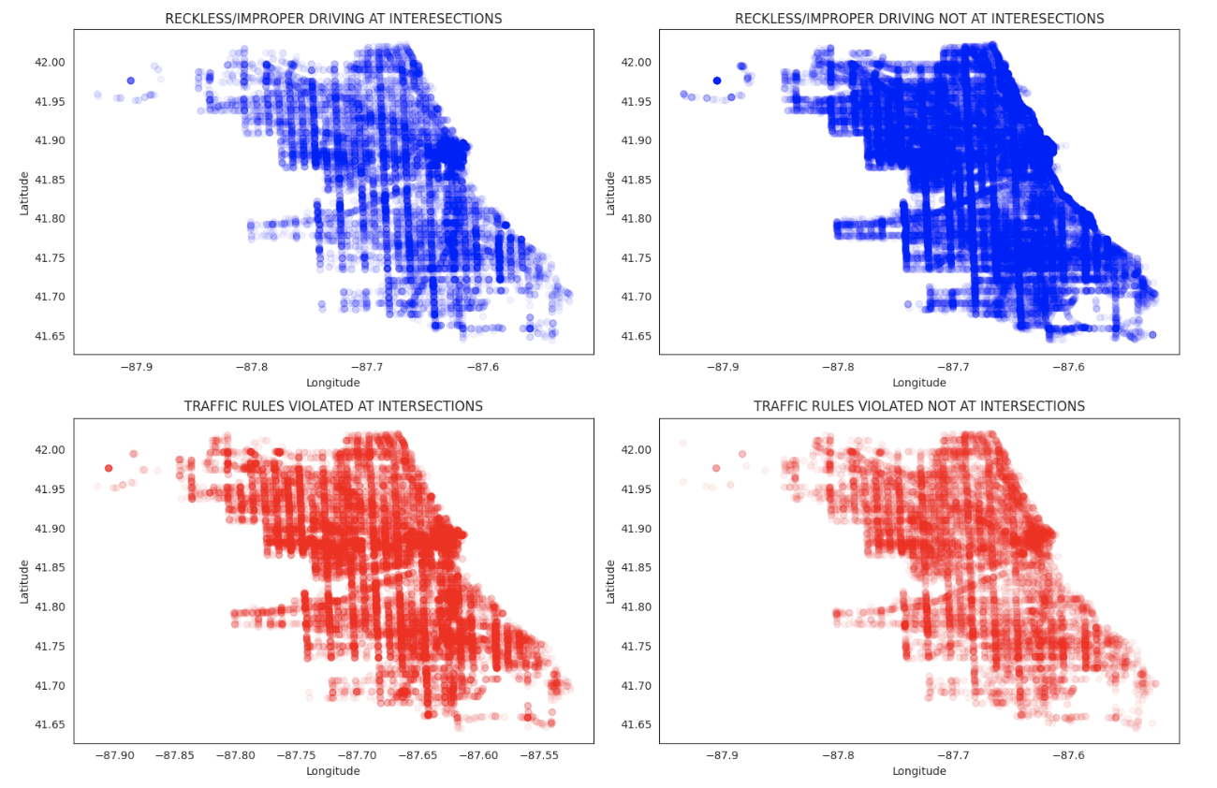
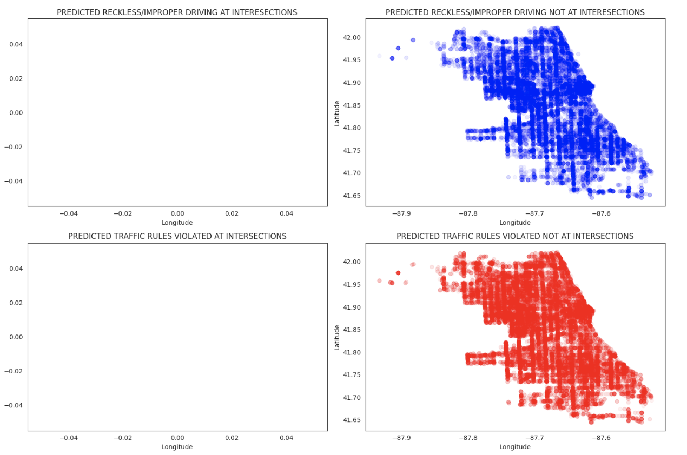
TOP FACTORS RESULTS – INTERSECTION COMPARISON
TRAINING
Unable to determine no intersection related crashes
Both causes are concentrated in densely populated areas
PREDICTED
Notes:
LOCATION BASED:
Latitude, longitude, Intersection
Driver Based:
Driver_Action, Physicial Condition, Maneuver
Traffic based:
First Contact Point, Num of units, Device Condition
Nature based:
Weather Condition

Slide 9
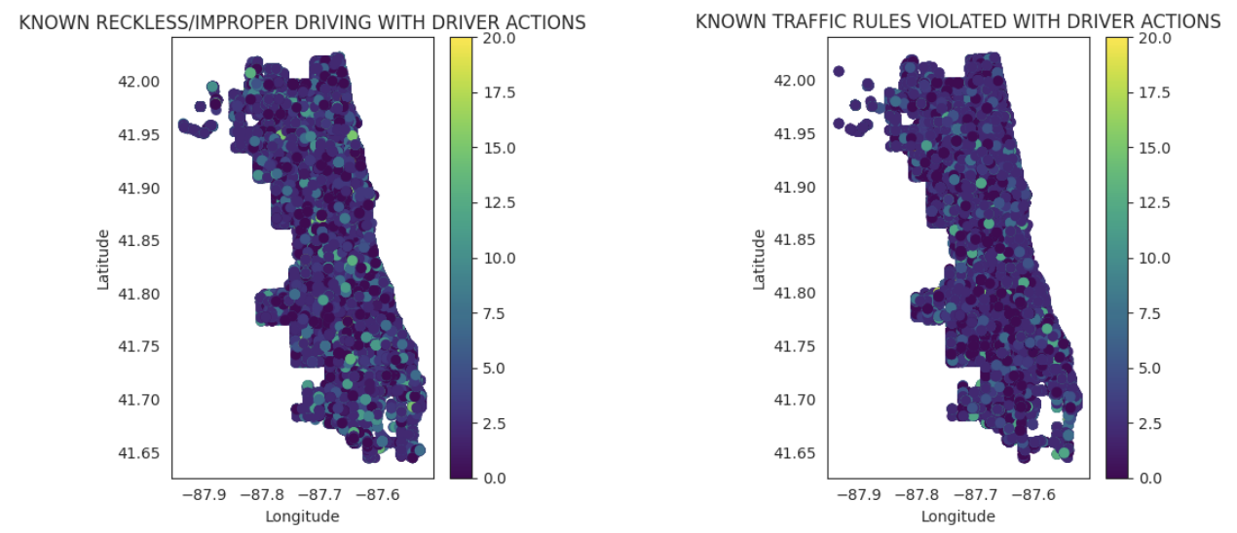
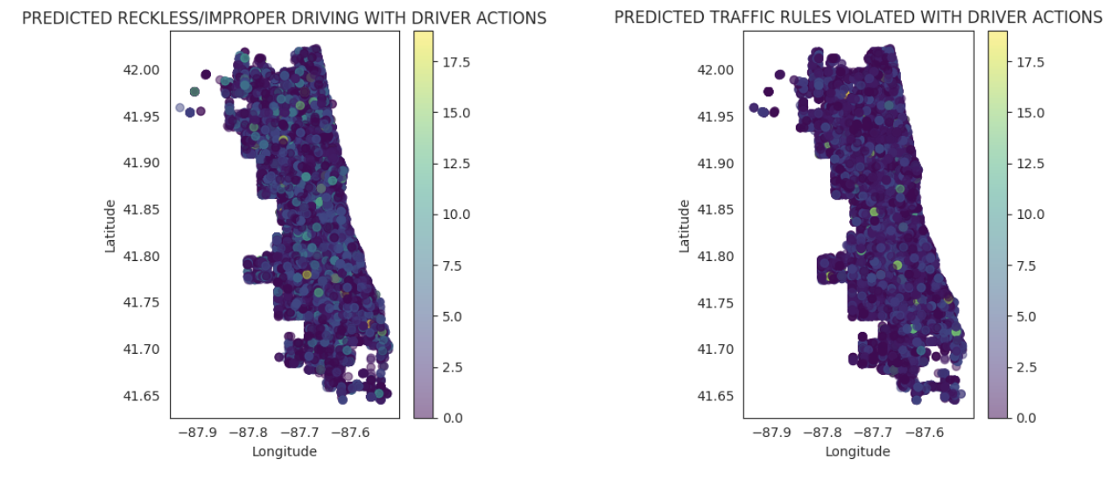
TOP FACTORS RESULTS – DRIVER ACTION
TRAINING
Similar Trend
Difficult to distinguish a discernable pattern
Recommend further insights analysis
PREDICTED
Notes:
LOCATION BASED:
Latitude, longitude, Intersection
Driver Based:
Driver_Action, Physicial Condition, Maneuver
Traffic based:
First Contact Point, Num of units, Device Condition
Nature based:
Weather Condition

Slide 10
IMPROVEMENTS
Higher Granularity
Increased Model Iterations
Improve Sampling Methods and fill in gaps in original data
Use missing factors such as Traffic Volume and Congestion Percentages
Notes:
RECOMMENDATIONS
IMPROVEMENTS
NEXT STEPS

Slide 11
RECOMMENDATIONS
Research the trends tied with location factors
Explore how driver actions impact crashes
Develop mobility engineering plans and awareness campaigns
Improve performance of model
Notes:
RECOMMENDATIONS
IMPROVEMENTS
NEXT STEPS

Slide 12
QUESTIONS?
Notes:
DATA SOURCE
WENT THROUGH CLEANING
4 DIFFERENT MODELS

Slide 13
CHICAGO DOT CAR CRASHES ANALYSIS
05/08/2023

Slide 14
BACKUP
Notes:
DATA SOURCE
WENT THROUGH CLEANING
4 DIFFERENT MODELS

Slide 15
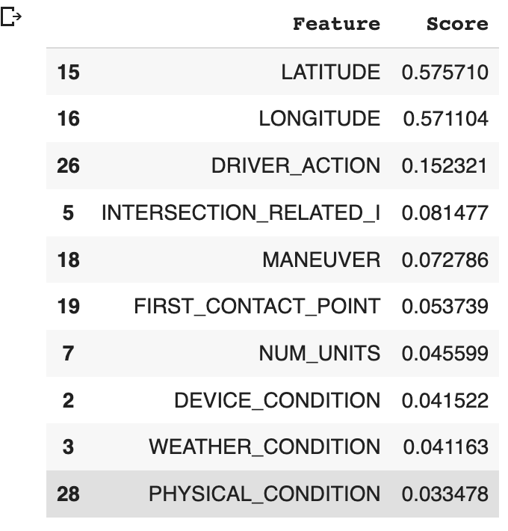
Notes:
DATA SOURCE
WENT THROUGH CLEANING
4 DIFFERENT MODELS

Slide 16
